Slide 1
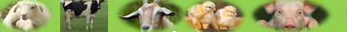
Artificial Breeding Technologies in Livestock Production
Michael Luwe
Department of Animal Health and Livestock Development

Slide 2
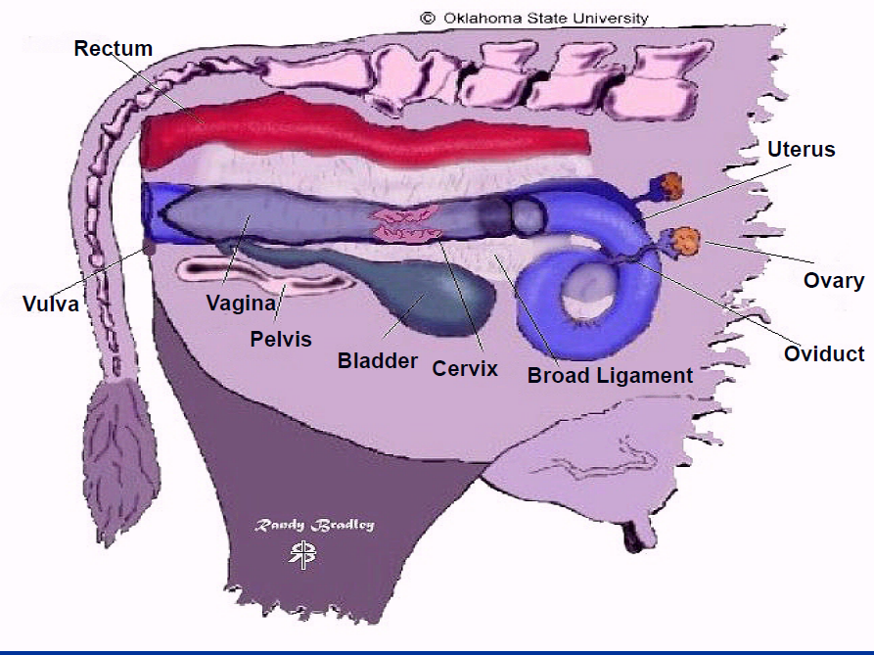
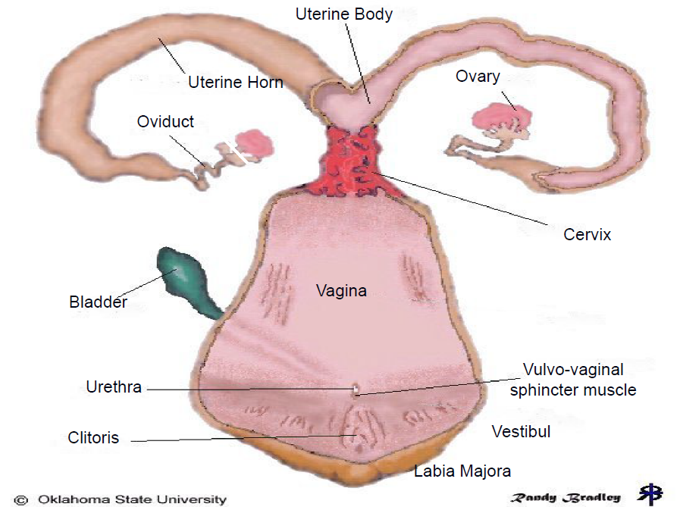
Anatomy of the female Reproductive Tract

Slide 3
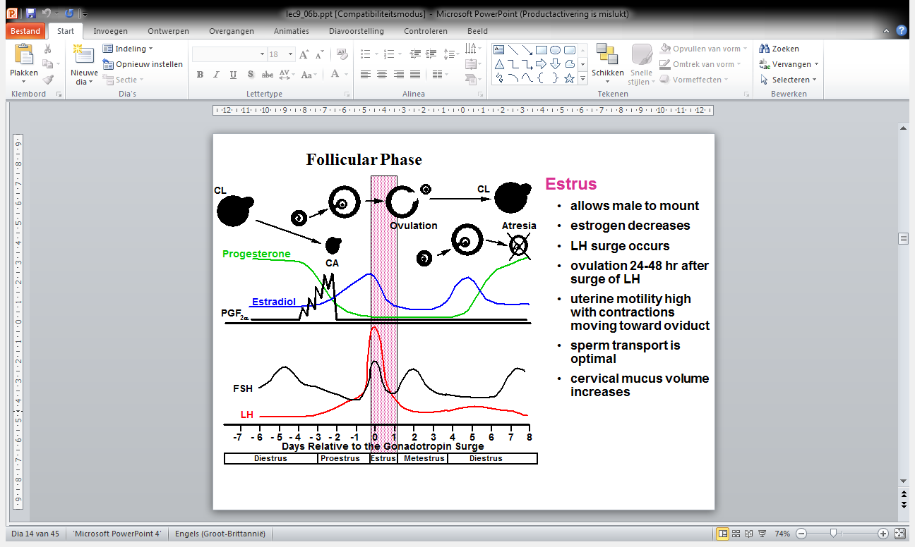
Reproductive Endocrinology

Slide 4
Artificial Insemination
Artificial insemination (AI) has many advantages to offer the dairy farmer, but problems of oestrus detection limit the value of AI in beef herds.
Some of the most important advantages of AI include:
Genetic gain – access to genetic material from superior bulls that can be carefully tested.
Cost effectiveness – no need to maintain a bull
Disease control – reduced risk of venereal diseases.
Safety – bulls are potentially dangerous
Flexibility – impracticable to keep enough bulls to cover all possible requirements
Fertility management – inseminations controlled and recorded.

Slide 5
Artificial Insemination
Insemination should not be done earlier than 40 – 60 days in high producing cows.
Insemination done at an earlier date will reduce high breeding efficiency.
The cow is in oestrus for about 18 hours and ovulation occur about 12 hours after the end of oestrus. Therefore timing of insemination becomes essential in relation to ovulation.
This practically means that insemination of cows in heat in the morning, should be done in the afternoon of the same day. Cows coming on heat in the afternoon must be bred in the morning of the following day

Slide 6
Artificial Insemination
The artificial breeding program depends on the inherent fertility, health, nutrition, and management of both the cows and the bulls, as well as on the ability of the handlers to preserve, store, and deliver an adequate dose of viable semen to the cow at the proper time during the estrous cycle.
Processed semen can be stored in liquid Nitrogen at -196 ºC for long-term storage.
Maintenance of low temperatures is important to the successful storage of frozen semen.
Diluted semen is packed into thin, plastic tubes of 0.25 or 0.5 ml capacity.
Notes:
a single straw may contain 20 x 10^6 spermatozoa

Slide 7
Artificial Insemination
The cow to be inseminated must be in oestrus without any doubt and should be properly prepared for the insemination.
The usual procedure is to immerse the straws in water at 35°C for 20 – 30 seconds when using 0.25ml straws or 40 – 60 seconds for 0.5ml straws.
Cold shock is the irreversible injury to sperm caused by a rapid decrease in semen temperature above freezing after thawing.
Cold shock occurs when semen is thawed and then subjected to cold environmental temperatures before insemination.
Notes:
Thawing of the semen needs to be rapid; slow thawing allows recrystallisation of ice within the cells, causing membrane damage.

Slide 8
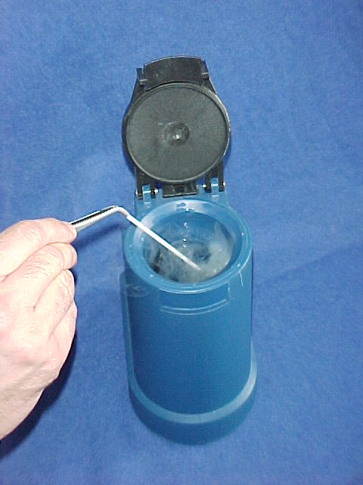
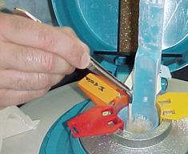
Artificial Insemination Procedure
Remove the straws using tweezers as quickly as possible (recommended time is between 3-5 sec.); thaw only the straws you will use within 10 to 15 min. NEVER ALLOW SEMEN TO REFREEZE
Shake straw to remove excess Nitrogen and quickly plunge into the thawing unit for not less than 30 seconds. Do not thaw more than one straw at any (one)time.

Slide 9
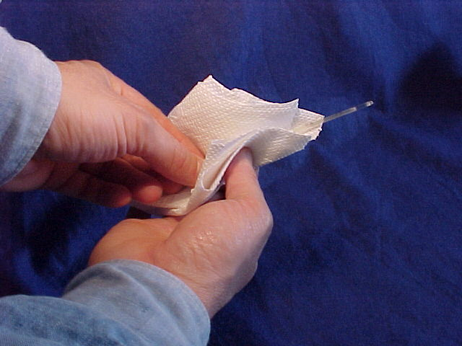
Artificial Insemination Procedure
During the thawing period pre-warm the gun by stroking it vigorously with a paper towel five or six times; During HOT WEATHER, before loading the straw, make sure the gun is not too hot as it will heat the semen.
After the thawing period remove the straw from the water and dry it completely. WATER IS LETHAL TO SPERMATOZOA

Slide 10
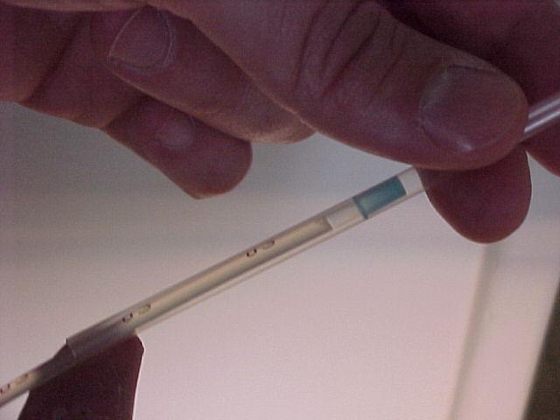
Artificial Insemination Procedure
Cut the end of the straw with a pair of scissors. Care must be taken so that the end of the straw is not crimped, thus preventing a secure fit into the inseminating sheath. After cutting, wipe the scissors with a clean paper towel.
Carefully place the straw into the insemination sheath
Place the stainless inseminating gun over the straw and slide the gun between the sheath and the straw. Gently push the gun and the straw toward the end of the plastic sheath.

Slide 11
Artificial Insemination Procedure
Locate the cervix through the rectal wall by using a gloved hand.
Clean the vulva thoroughly prior to insertion of the breeding gun with a dry paper towel.
Insert the insemination gun at a 30° angle to avoid the urethral opening.
Pass rod through cervix, check location (uterine body) with the tip of index finger and slowly deposit the semen.

Slide 12
Embryo transfer and multiple ovulation technology
The first viable mammalian embryo transfer was performed by Heape (1890) in a rabbit.
The development of embryo transfer in cattle was to further the increase in genetic progress made possible by the adoption of AI.
It offers a means of transporting livestock between countries at less expense and without the trauma associated with the transport of adult animals.
It also helps in obtaining fertilized embryos from superior old cows that can no longer breed normally.

Slide 13
Embryo transfer and multiple ovulation technology
Procedure:
1. Selection of donor cow
Super ovulation: Hormonal treatment to enable a cow to ovulate several ova, as opposed to the normal single egg, in an estrus cycle.
Hormones: PMSG, FSH (from sheep and swine) the treatment to start on day 9 – 14 of the cycle.
48hrs after PMSG injection, prostaglandin f2α or analogue
3. Recipient cows must be synchronous with a donor

Slide 14
Embryo transfer and multiple ovulation technology
Synchronizing recipient cows artificially with prostaglandin F2 α 12 hrs before the donor cow is injected for estrus induction. Apart from prostaglandin can also use;
Artificial corpus luteum (Progesterone Releasing Intra-vaginal Device {PRID});
Ear implants (for ten days)
Donor cow is inseminated 12 hrs after the start of standing heat. Repeat 12 hrs later if estrus has not stopped.

Slide 15
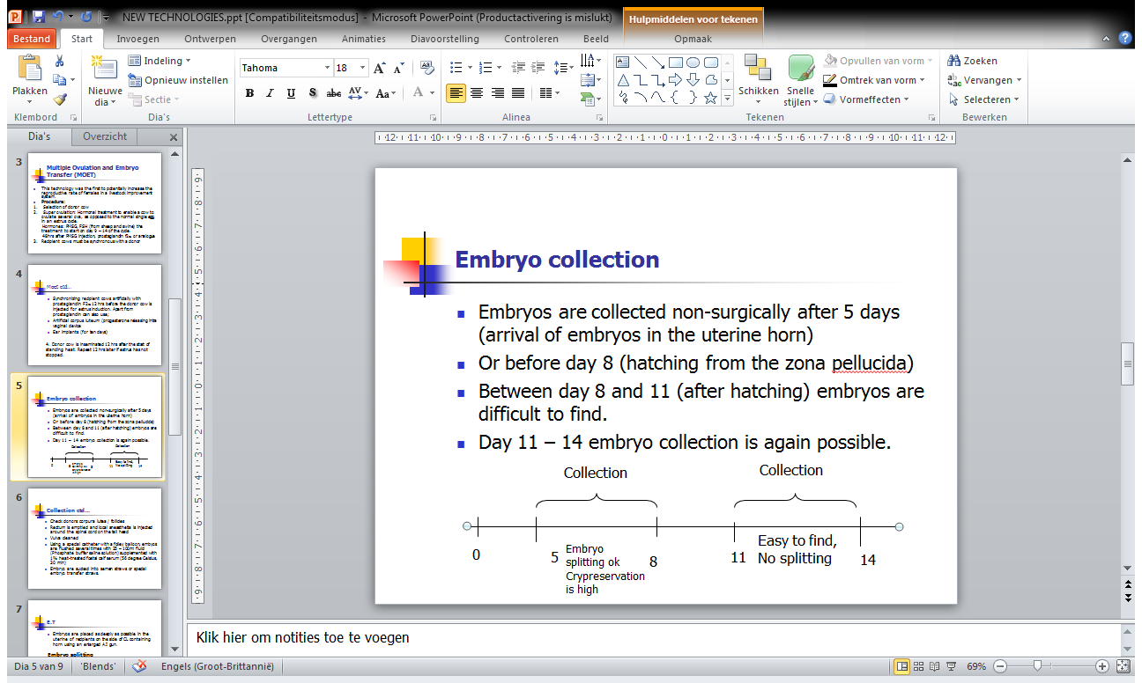
Embryo transfer and multiple ovulation technology
Embryos are collected non-surgically after 5 days (arrival of embryos in the uterine horn)
Or before day 8 (hatching from the zona pellucida)
Between day 8 and 11 (after hatching) embryos are difficult to find.
Day 11 – 14 embryo collection is again possible.

Slide 16
Embryo transfer and multiple ovulation technology
Check donors corpura lutea / follicles
Rectum is emptied and local anaesthesia is injected around the spinal cord on the tail head
Vulva cleaned
Using a special catheter with a Folley balloon, embyos are flushed several times with 25 – 100ml fluid (Phosphate buffer saline solution) supplemented with 1% heat-treated foetal calf serum (56 degree Celsius, 30 min)
Embryo are sucked into semen straws or special embryo transfer straws.

Slide 17
Embryo transfer and multiple ovulation technology
Embryos are placed as deeply as possible in the uterine of recipients on the side of CL containing horn using an enlarged A.I gun.
Embryo splitting
It is possible to split the embryos into halves, triplets or quadruplets in order to calves per donor cow.
Cloning: Cloning is defined as the production of identical animals

Slide 18
Oestrous synchronization technology
It involves the use exogenous hormone treatments to control oestrus and ovulation for the benefit and convenience of the cattle breeder.
Synchronization of oestrus allows the batch management of inseminations and calvings which in some circumstances would improve the efficiency of management.
It may shorten the calving to conception interval, and thus the calving interval and possibly the calving season, particularly in beef herds.
ASSIGNMENT: DISADVANTAGES OF SYNCHRONIZATION

Slide 19
Principles and methods of cycle control
The control of the oestrous cycle is dependent on manipulation of hormonal changes in order to cause ovulation at a predetermined, convenient time, rather than when it would have occurred naturally.
There are three main approaches:
The artificial induction of premature luteolysis using luteolytic agents such as prostaglandin F2a (PGF2a). This will obviously only be effective in cycling cows with an active corpus luteum.

Slide 20
Principles and methods of cycle control
Prostaglandin-induced luteolysis in association with GnRH to manipulate follicular and luteal function. This procedure could potentially be used for the induction of ovulation in acyclic as well as cyclic cows.
The simulation of corpus luteum function, by administration of progesterone (or one of its synthetic derivatives) for a number of days, followed by abrupt withdrawal. This procedure is also effective for the induction of ovulation in acyclic cows. E.g. PRID, Melengestrol acetate (MGA)

Slide 21
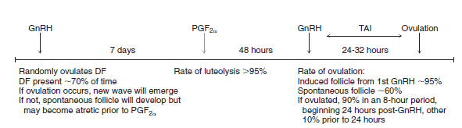
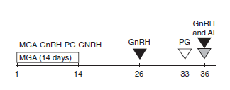
Examples on oestrus synchronization protocols
i. Using PGF and GnRH
ii. Using MGA

